Slide 1


Slide 2
Function
Function is a block of code that has a name and used to perform some specific task. The function contains the set of programming statements enclosed by curly bracket { }. A function can be called multiple times, so it is reusable.
Using the function we can divide a large program into small blocks known as function.

Slide 3
Function
Advantages
By using functions, we can avoid rewriting same logic/code again and again in a program.
We can call C functions any number of times in a program and from any place in a program.
We can track a large C program easily when it is divided into multiple functions.
Reusability is the main achievement of C functions.
However, Function calling is always a overhead in a C program.

Slide 4
Function
Aspects
There are three aspects of a C function .
Function Declaration A function must be declared globally in a c program to tell the compiler about the function name, function parameters, and return type.
Function Call Function can be called from anywhere in the program. The parameter list must not differ in function calling and function declaration. We must pass the same number of functions as it is declared in the function declaration.
Function Definition It contains the actual statements which are to be executed. It is the most important aspect to which the control comes when the function is called. Here, we must notice that only one value can be returned from the function.

Slide 5
Function
Types
There are two types of function in C programming
Predefined Function ( Library Function )
User Defined Function

Slide 6
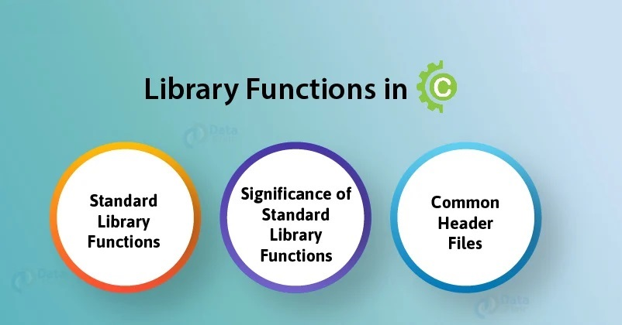

Slide 7
Library Function
Standard Library Functions are basically the inbuilt functions in the C compiler that makes things easy for the programmer.
Library functions are built-in functions that are grouped together and placed in a common location called library.
Example: stdio.h is a header files that contains some standard functions such as printf(), scanf(), gets(), puts() etc.

Slide 8
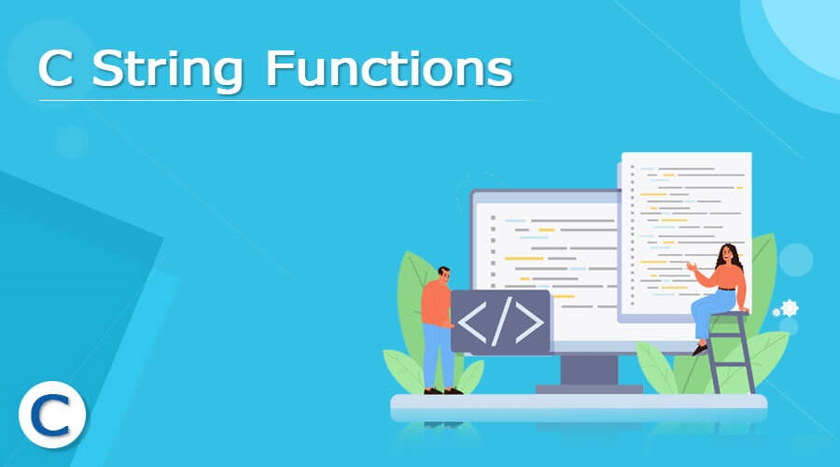

Slide 9
String Function
Strings are an array of characters. We can perform several operation on string to manipulate the strings. Such as finding length of string, comparing two string, displaying formatted output etc. using string function.
All the string functions are available in string.h header file.

Slide 10
String Function
strlen()
String function strlen() is used to find the length of given string. It does not count null (‘\0’) character. It returns number of character of the string.
Example: If you want to find the length of “Computer” it returns 8.

Slide 11
strlen()
Program - 1
#include <stdio.h>
#include <string.h>
int main()
{
char str[25];
printf("Enter string : ");
scanf("%s",&str);
printf(“String length is : %d",strlen(str));
}
OUTPUT
Enter string : Computer
String length is : 8

Slide 12
strlen()
Program - 2
#include <stdio.h>
#include <string.h>
int main()
{
char str[25];
int i = 0;
printf("Enter string : ");
gets(str);
while(str[i] != '\0')
{
i = i + 1;
}
printf(“String length = %d”,i);
}
OUTPUT
Enter string : C Fun
String length is : 5

Slide 13
String Function
strrev()
String function strrev() is used to reverse a string.
Example: If you want to reverse string it shows “Hello” as “olleH”.

Slide 14
strrev()
Program - 1
#include <stdio.h>
#include <string.h>
int main()
{
char str[25];
printf("Enter string : ");
scanf("%s",&str);
printf(“Reverse string is : %s",strrev(str));
return 0;
}
OUTPUT
Enter string : CU
Reverse string is : UC

Slide 15
String Function
strcpy()
String function strcpy() is used to copy source value to destination variable.
Example: If you want to copy one string to another the syntax is.
Syntax: strcpy (destination, source);

Slide 16
strcpy()
Program - 1
#include <stdio.h>
#include <string.h>
int main()
{
char str1[25], str2[25];
printf("Enter string : ");
scanf("%s",&str1);
strcpy( str2, str1);
printf(“Value of str2 is : %s",str2);
}
OUTPUT
Enter string : Hello
Value of str2 is : Hello

Slide 17
String Function
strncpy()
String function strncpy() is known as bounded string copy it is used to copy n (specified) number of character source value to destination variable.
Example: If you want to copy one string to another with specified number of character the syntax is.
Syntax: strncpy (destination, source, n);

Slide 18
strncpy()
Program - 1
#include <stdio.h>
#include <string.h>
int main()
{
char str1[25] = “C Program”, str2[25];
int n = 5;
strncpy( str2, str1, n);
printf(“Value of str2 is : %s",str2);
return 0;
}
OUTPUT
Value of str2 is : C Pro

Slide 19
strncpy()
Program - 2
#include <stdio.h>
#include <string.h>
int main()
{
char str1[25], str2[25];
int n;
printf(“Enter string : “);
gets(str1);
printf(“Enter no. of character to be copy : “);
scanf(“%d”,&n);
strncpy( str2, str1, n);
printf(“Value of str2 is : %s",str2);
}
OUTPUT
Enter string : Hello C
Enter no of char : 5
Value of str2 is : Hello

Slide 20
String Function
strcat()
String function strcat() function concatenates two strings and result is returned to source string.
Example: If you want to concatenate one string to another strcat is used.
Syntax: strcat (source, new_string);

Slide 21
strcat()
Program - 1
#include <stdio.h>
#include <string.h>
int main()
{
char str1[25];
printf(“Enter string : “);
gets(str1);
strcat( str1, “ming”);
printf(“Value of str1 is : %s",str1);
}
OUTPUT
Enter string : C Program
Value of str2 is : C Programming

Slide 22
strcat()
Program - 2
#include <stdio.h>
#include <string.h>
int main()
{
char fname[25]=“Peter”, lname[25]=“Smith”;
strcat(fname,” “);
strcat(fname, lname);
printf(“Full name is : %s",fname);
}
OUTPUT
Full name is : Peter Smith

Slide 23
String Function
strcmp()
String function strcmp() function is used to compare two strings if strings are identical then it returns 0 otherwise it returns non zero values. It is case sensitive it means it checks small and capital letter.
Example: “Hello” and hello is not same.
Syntax: strcmp (String1, String2);

Slide 24
strcmp()
Program - 1
#include <stdio.h>
#include <string.h>
int main()
{
char str1[25]="Hello";
char str2[25]="hello";
int n=strcmp(str1,str2);
if(n==0)
printf("Both strings are equal");
else
printf("Strings are not equal");
return 0;
}
OUTPUT
Strings are not equal

Slide 25
String Function
stricmp()
String function stricmp() function is used to compare two strings if strings are identical then it returns 0 otherwise it returns non zero values. If we use stricmp it means it ignores small and capital letter it will check spelling only.
Example: “Hello” and hello is the same.
Syntax: stricmp (String1, String2);

Slide 26
stricmp()
Program - 1
#include <stdio.h>
#include <string.h>
int main()
{
char str1[25]="Hello";
char str2[25]="hello";
int n = stricmp(str1,str2);
if(n == 0)
printf("Both strings are equal");
else
printf("Strings are not equal");
return 0;
}
OUTPUT
Strings are equal

Slide 27
String Function
strncmp()
String function strncmp() function is used to compare two strings at specified number of character with case sensitivity, if strings are identical then it returns 0 otherwise it returns non zero values.
Syntax: strncmp (String1, String2, n);

Slide 28
strncmp()
Program - 1
#include <stdio.h>
#include <string.h>
int main()
{
char str1[25] = “Wonderful";
char str2[25] = “Wonderer";
int n = strncmp(str1,str2,7);
if(n == 0)
printf("Both strings are equal");
else
printf("Strings are not equal");
return 0;
}
OUTPUT
Strings are not equal

Slide 29
String Function
strlwr()
String function strlwr() returns given string in lowercase.
Syntax: strlwr (String1);

Slide 30
strlwr()
Program - 1
#include <stdio.h>
#include <string.h>
int main()
{
char str1[25]=“Hello";
printf(“Str1 = %s\n“,str1);
printf(“Lowercase = %s\n“,strlwr(str1));
return 0;
}
OUTPUT
Str1 = Hello
Lowercase = hello

Slide 31
String Function
strupr()
String function strupr() returns given string in uppercase letter.
Syntax: strupr (String1);

Slide 32
strupr()
Program - 1
#include <stdio.h>
#include <string.h>
int main()
{
char str1[25]=“Hello";
printf(“Str1 = %s\n“,str1);
printf(“Uppercase = %s\n“,strupr(str1));
return 0;
}
OUTPUT
Str1 = Hello
Uppercase = HELLO

Slide 33
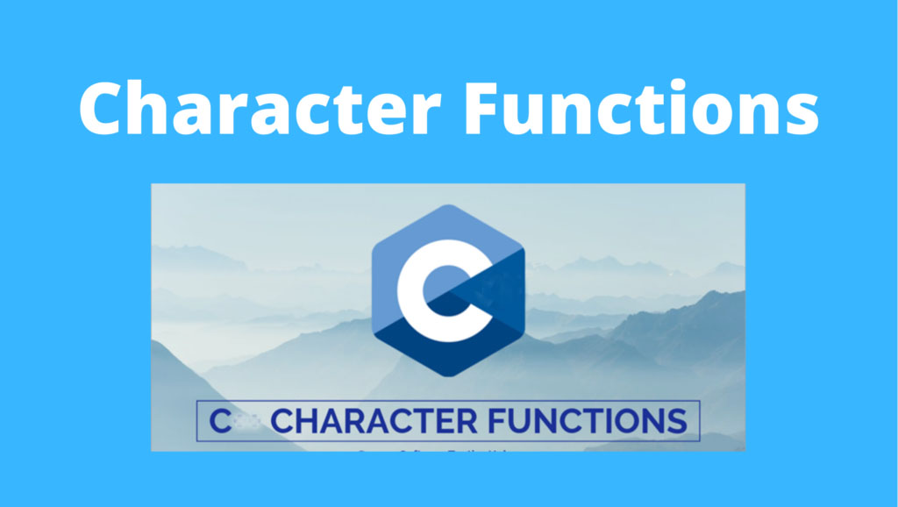

Slide 34
Character Function
All data is entered into computers as characters, which includes letters, digits and various special symbols.
The character-handling library includes several functions that perform useful tests and manipulations of character data.
Character functions need ctype.h header file to be included in the program. Different character functions provided by C Language are:

Slide 35
Character Function
isalpha()
isalpha() function in C language checks whether given character is alphabet or not.
The isalpha function returns a nonzero value if c is alphabetic and returns zero if c is not alphabetic.
Syntax: int isalpha(int c);

Slide 36
isalpha()
Program - 1
#include <stdio.h>
#include <ctype.h>
int main()
{
char ch;
printf("Enter any character : ");
scanf("%c",&ch);
if(isalpha(ch))
printf("Entered character is alphabetic\n");
else
printf("Entered character is not alphabetic\n");
return 0;
}
OUTPUT
Enter any character : A
Enter character is alphabetic

Slide 37
Character Function
isalnum()
isalnum() function in C language checks whether given character is alphanumeric or not.
The isalnum function returns a nonzero value if c is alphanumeric and returns zero if c is not alphanumeric.
Syntax: int isalnum(int c);

Slide 38
isalnum()
Program - 1
#include <stdio.h>
#include <ctype.h>
int main()
{
char ch;
printf("Enter any character : ");
scanf("%c", &ch);
if ( isalnum ( ch ) )
printf("Entered character is alphanumeric\n");
else
printf("Entered character is not alphanumeric\n");
return 0;
}
OUTPUT
Enter any character : A or 4
Enter character is alphanumeric

Slide 39
Character Function
isdigit()
isdigit() function in C language checks whether given character is digit or not.
The isdigit function returns a nonzero value if c is digit and returns zero if c is not a digit.
Syntax: int isdigit(int c);

Slide 40
isdigit()
Program - 1
#include <stdio.h>
#include <ctype.h>
int main()
{
char ch;
printf("Enter any character : ");
scanf("%c", &ch);
if ( isdigit ( ch ) )
printf ( "Entered character is digit\n" ) ;
else
printf ( "Entered character is not digit\n" ) ;
return 0;
}
OUTPUT
Enter any character : 4
Enter character is digit

Slide 41
Character Function
islower()
islower() function in C language checks whether given character is lowercase or not.
The islower function returns a nonzero value if c is lowercase letter and returns zero if c is not a lowercase letter.
Syntax: int islower(int c);

Slide 42
islower()
Program - 1
#include <stdio.h>
#include <ctype.h>
int main()
{
char ch;
printf("Enter any character : ");
scanf("%c", &ch);
if(islower(ch))
printf(“Lower case\n" ) ;
else
printf(“Not a lower case\n" ) ;
return 0;
}
OUTPUT
Enter any character : a
Lower case

Slide 43
Character Function
isupper()
isupper() function in C language checks whether given character is uppercase or not.
The isupper function returns a nonzero value if c is uppercase letter and returns zero if c is not a uppercase letter.
Syntax: int isupper(int c);

Slide 44
isupper()
Program - 1
#include <stdio.h>
#include <ctype.h>
int main()
{
char ch;
printf("Enter any character : ");
scanf("%c", &ch);
if(isupper(ch))
printf(“Upper case\n" ) ;
else
printf(“Not an upper case\n" ) ;
return 0;
}
OUTPUT
Enter any character : A
Upper case

Slide 45
Character Function
tolower()
tolower() function in C language checks whether given character is alphabetic and convert it to lowercase.
The tolower function returns c as a lowercase letter. If c is already lowercase, the tolower function returns c unchanged.
Syntax: int tolower(int c);

Slide 46
tolower()
Program - 1
#include <stdio.h>
#include <ctype.h>
int main()
{
char ch;
printf("Enter any character : ");
scanf("%c", &ch);
if(isalpha(ch))
printf(“Lower case : %c\n“,tolower(ch)) ;
else
printf(“Not an alphabetic") ;
return 0;
}
OUTPUT
Enter any character : A
Lower case : a

Slide 47
Character Function
toupper()
toupper() function in C language checks whether given character is alphabetic and convert it to uppercase.
The toupper function returns c as a uppercase letter. If c is already uppercase, the toupper function returns c unchanged.
Syntax: int toupper(int c);

Slide 48
toupper()
Program - 1
#include <stdio.h>
#include <ctype.h>
int main()
{
char ch;
printf("Enter any character : ");
scanf("%c", &ch);
if(isalpha(ch))
printf(“Upper case : %c\n“,toupper(ch)) ;
else
printf(“Not an alphabetic") ;
return 0;
}
OUTPUT
Enter any character : d
Upper case : D

Slide 49
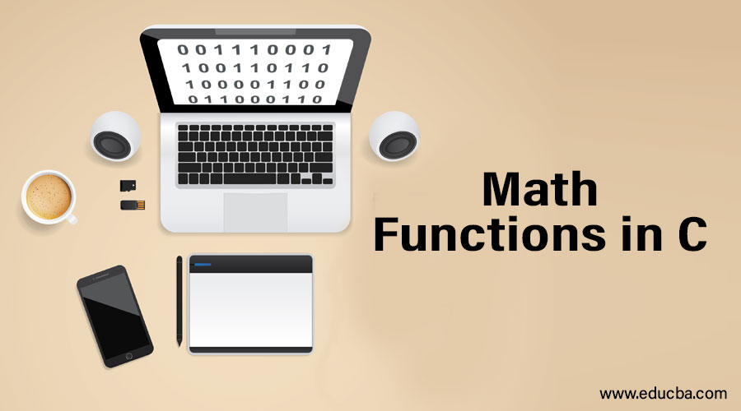

Slide 50
Mathematical Function
C Programming allows us to perform mathematical operations through the functions defined in <math.h> header file. The <math.h> header file contains various methods for performing mathematical operations.
Some mathematical functions are:
abs (number)
ceil (number)
floor (number)
pow (d1,d2)
sqrt (number)

Slide 51
Mathematical Function
abs (number) – Returns the absolute value of given number.
ceil (number) – Rounds up the given number. It returns the integer value which is greater than or equal to given number.
floor (number) – Rounds down the given number. It returns the integer value which is less than or equal to given number.
pow (d1, d2) – Returns the power of given number.
sqrt (number) – Returns the square root of given number.

Slide 52
Math
Program - 1
#include <stdio.h>
#include <math.h>
int main()
{
printf("%d",abs(-12));
printf("\n%.2f",ceil(3.6));
printf("\n%.2f",ceil(3.3));
printf("\n%.2f",floor(3.6));
printf("\n%.2f",floor(3.3));
printf("\n%.2f",sqrt(16));
printf("\n%.2f",sqrt(7));
printf("\n%.2f",pow(2,4));
printf("\n%.2f",pow(3,3));
return 0;
}
OUTPUT
12
4.00
4.00
3.00
3.00
4.00
2.00
16.00
27.00

Slide 53


Slide 54
User Defined Function
The function which are created by the programmer is known as user defined function. These methods are modified according to the requirement.

Slide 55
User Defined Function
Syntax
Return_Type Function_Name( )
{
Statements;
}
NOTE: Return_Type can be void or can be any one of the data types.

Slide 56
User Defined Function
Example
void disp( )
{
printf(“Hello World);
}

Slide 57
User Defined Function
Program - 1
#include <stdio.h>
void disp()
{
printf(“Hello World\n”);
}
int main()
{
disp();
disp();
return 0;
}
OUTPUT
Hello World
Hello World

Slide 58
User Defined Function
Argument Function
We can create a variable in the function parenthesis known as argument and these types of function is known as argument function.
When a function has arguments, it receives any data from the calling function but it returns no values.

Slide 59
Argument Function
Syntax
Function Declaration
Return_Type Function_Name ( Parameter List );
Function Definition
Return_Type Function_Name ( Parameter_List )
{
Statements;
}

Slide 60
Argument Function
Example - 1
#include<stdio.h>
void add( int, int); // Function Declaration
int main()
{
add( 10, 20 );
return 0;
}
void add ( int x, int y ) // Function Definition
{
int res = x + y;
printf(“Sum = %d”,res);
}
OUTPUT
Sum = 30

Slide 61
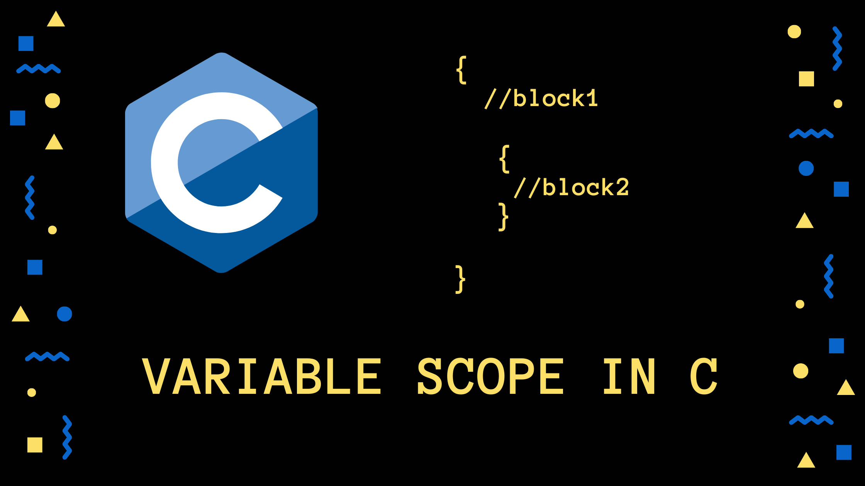

Slide 62
Variable Scope in Function
In simple terms, scope of a variable is its lifetime in the program.
This means that the scope of a variable is the block of code in the entire program where the variable is declared, used, and can be modified.
There are two scope of variable in C programming.
Local Scope of Variable
Global Scope of Variable

Slide 63
Local Scope Variable
A variable that is declared inside the function or block is called a local variable.
It must be declared at the start of the block.
void function1()
{
int x = 10; // Local Variable
}

Slide 64
Local Scope Variable
Example - 1
#include<stdio.h>
void add() // Function Definition
{
int val = 100;
}
int main()
{
printf(“Value of val = %d”,val);
return 0;
}
OUTPUT
Val was not declared in this scope

Slide 65
Local Scope Variable
A variable that is declared inside the function or block is called a local variable.
It must be declared at the start of the block.
void function1()
{
int x = 10; // Local Variable
}

Slide 66
User Defined Function
Return Function
A C function may or may not return a value from the function. If you don't have to return any value from the function, use void for the return type.
If you want to return any value from the function, you need to use any data type such as int, long, char, etc. The return type depends on the value to be returned from the function.

Slide 67
Return Function
Syntax
Function Definition
Return_Type Function_Name ( )
{
Statements;
}
Example:
int display()
{
return 10;
}

Slide 68
Return Function
Example - 1
#include<stdio.h>
int display(); // Function Declaration
int main()
{
int x = display();
printf(“Display() = %d\n”,x);
return 0;
}
int display()
{
return 10; // display()=10
}
OUTPUT
Display() = 10

Slide 69
Return Function
Example - 2
#include<stdio.h>
int sum()
{
int n1,n2;
printf("Enter first numbers : ");
scanf("%d",&n1);
printf("Enter second number : ");
scanf("%d",&n2);
return n1+n2;
}
OUTPUT
Enter first number : 20
Enter second number :30
Sum of two numbers = 50
int main()
{
int result;
result = sum();
printf("Sum of two numbers = %d", result);
return 0;
}

Slide 70
User Defined Function
Return with Argument Function
An argument function in C can return a value. It means we can create a return function with argument.

Slide 71
User Defined Function
Example - 1
#include<stdio.h>
int sum(int n1, int n2) // sum(10,20) = 30
{
return n1+n2;
}
int main()
{
int x = sum(10,20);
printf("Sum = %d",x);
return 0;
}

Slide 72
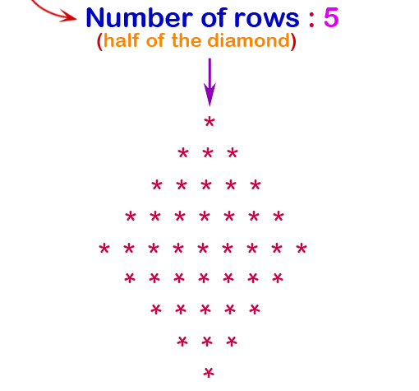
Nested For Loop
Example - 10
C program to display pattern given below

Slide 73
Nested For Loop
Example - 10
C program to display pattern given below
#include <stdio.h>
int main()
{
int i,j,spc,rows,k,t=1;
printf("Input number of rows : ");
scanf("%d",&rows);
spc=rows;//+4-1;
for(i=1;i<=rows;i++)
{
for(k=spc;k>=1;k--)
{
printf(" ");
}
for(j=1;j<=i;j++)
printf(“%d “,t++);
printf("\n");
spc--;
}
return 0;
}
OUTPUT
Enter no of rows : 4
1
2 3
4 5 6
7 8 9 10
Click here to see code

Slide 74
QUIZ

Slide 75
Quiz - 1
Predict the output of given code snippet
#include<stdio.h>
int abc(int i)
{
return (i++);
}
int main()
{
int i = abc(10);
printf("%d",--i);
}
OUTPUT
9
Click here to see code

Slide 76
Quiz - 2
#include <stdio.h>
int i = 6;
display()
{
i = 5;
}
int main()
{
display();
printf("%d\n",i);
return 0;
}
OUTPUT
5
Click here to see code

Slide 77
Quiz - 3
#include <stdio.h>
void my_func();
int main()
{
int my_num = 7;
printf("%d",my_num);
my_func();
return 0;
}
void my_func()
{
printf("%d",my_num);
}
OUTPUT
Error on my_num
Click here to see code

Slide 78
Coding Questions

Slide 79
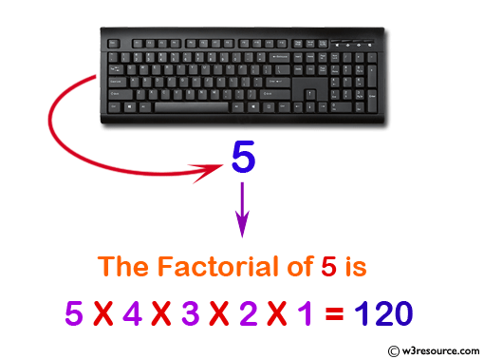
Factorial
Example - 1
Program to find factorial

Slide 80
Factorial
Example - 12
Program to find factorial
#include <stdio.h>
void main()
{
int i,f=1,num;
printf(“Enter number : ");
scanf("%d",&num);
for(i=1;i<=num;i++)
f=f*i;
printf("Factorial of %d is: %d\n",num,f);
}
OUTPUT
Error on my_num
Click here to see code

Slide 81
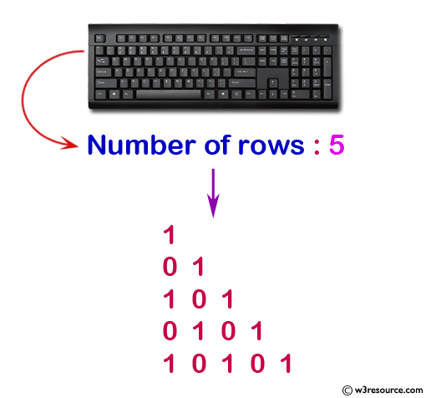
Floyd’s Triangle
Example - 2
Program to Floyd’s triangle

Slide 82
Floyd’s Triangle
Example - 2
Program to Floyd’s triangle
#include <stdio.h>
void main()
{
int i,j,n,p,q;
printf("Input number of rows : ");
scanf("%d",&n);
for(i=1;i<=n;i++)
{
if(i%2==0)
{
p=1;q=0;
}
else
{
p=0;q=1;
}
for(j=1;j<=i;j++)
if(j%2==0)
printf("%d",p);
else
printf("%d",q);
printf("\n");
}
return 0;
}
Click here to see code

Slide 83
Coding Questions
Write a C program to find cube of any number using function.
Write a C program to find diameter, circumference and area of circle using functions.
Write a C program to find maximum and minimum between two numbers using functions.
Write a C program to check whether a number is even or odd using functions.
Write a C program to check whether a number is prime, Armstrong or perfect number using functions.
Write a C program to find all prime numbers between given interval using functions.
Write a C program to print all strong numbers between given interval using functions.
Write a C program to print all Armstrong numbers between given interval using functions.
Write a C program to print all perfect numbers between given interval using functions.
Write a C program to find power of any number using recursion.

Slide 84
Coding Questions
11. Write a C program to calculate area of square using return function.
12. Write a program to calculate area and parameter of rectangle.
13. Write a program to check if entered character is alphabet or not using return function with argument.
14. Write a C program to check entered number is even or odd using return with argument function.
15.

